Slide 1
IT JOBS AND SALARIES TRENDS PREDICTION AND ANALYSIS
BY:
SANCHIT MANWAL
&
BHUPAL SINGH DANU

Slide 2
TABLE OF CONTENTS
Introduction
Problem statement and objectives
Methodology
Tools and technologies used
Data collection and preprocessing
Arima Model implementation
Prophet model implementation
LSTM Model implementation
Model Evaluation metrics
Power BI Visulaization
Future Scopes

Slide 3
INTRODUCTION
This project, titled "IT Jobs and Salary Prediction and Analysis," focuses on using modern tools and technologies to collect, analyze, and forecast job market trends.
The tech stack combines:
Web scraping tools to collect real-time job data
Python libraries for data processing and modeling
Forecasting models like ARIMA, Prophet, and LSTM
Power BI for creating interactive dashboards
The goal is to assist job seekers, recruiters, and analysts by providing data-driven insights into high-demand roles, salaries, and skills.

Slide 4
PROBLEM STATEMENT & OBJECTIVES
Problem Statement
The IT job market is dynamic and rapidly evolving. Job seekers and recruiters often lack real-time insights into:
Salary Trends
In-demand Skills
Role Specific demand across Locations
There is need for a predictive system to analyse and forecast these trends accurately .
Project Objectives
Collect and analyze job listings from popular portals
Predict salary trends using time series and ML models
Identify in-demand roles, skills, and job locations
Visualize insights through an interactive dashboard

Slide 5
METHODOLOGY
PROJECT WORKFLOW
Data Collection
Web scraping job listings using Selenium + BeautifulSoup
Sources: Naukri.com, Kaggle, etc.
Data Preprocessing
Cleaning, filtering, encoding using Pandas, NumPy
Feature selection & transformation
Model Building
Forecasting using ARIMA, Prophet, and LSTM models
Evaluation
Performance comparison using error metrics (MAPE, SMAPE and MASE)
Visualization
Interactive dashboards in Power BI
Graphs, filters, trends for easy insight delivery

Slide 6
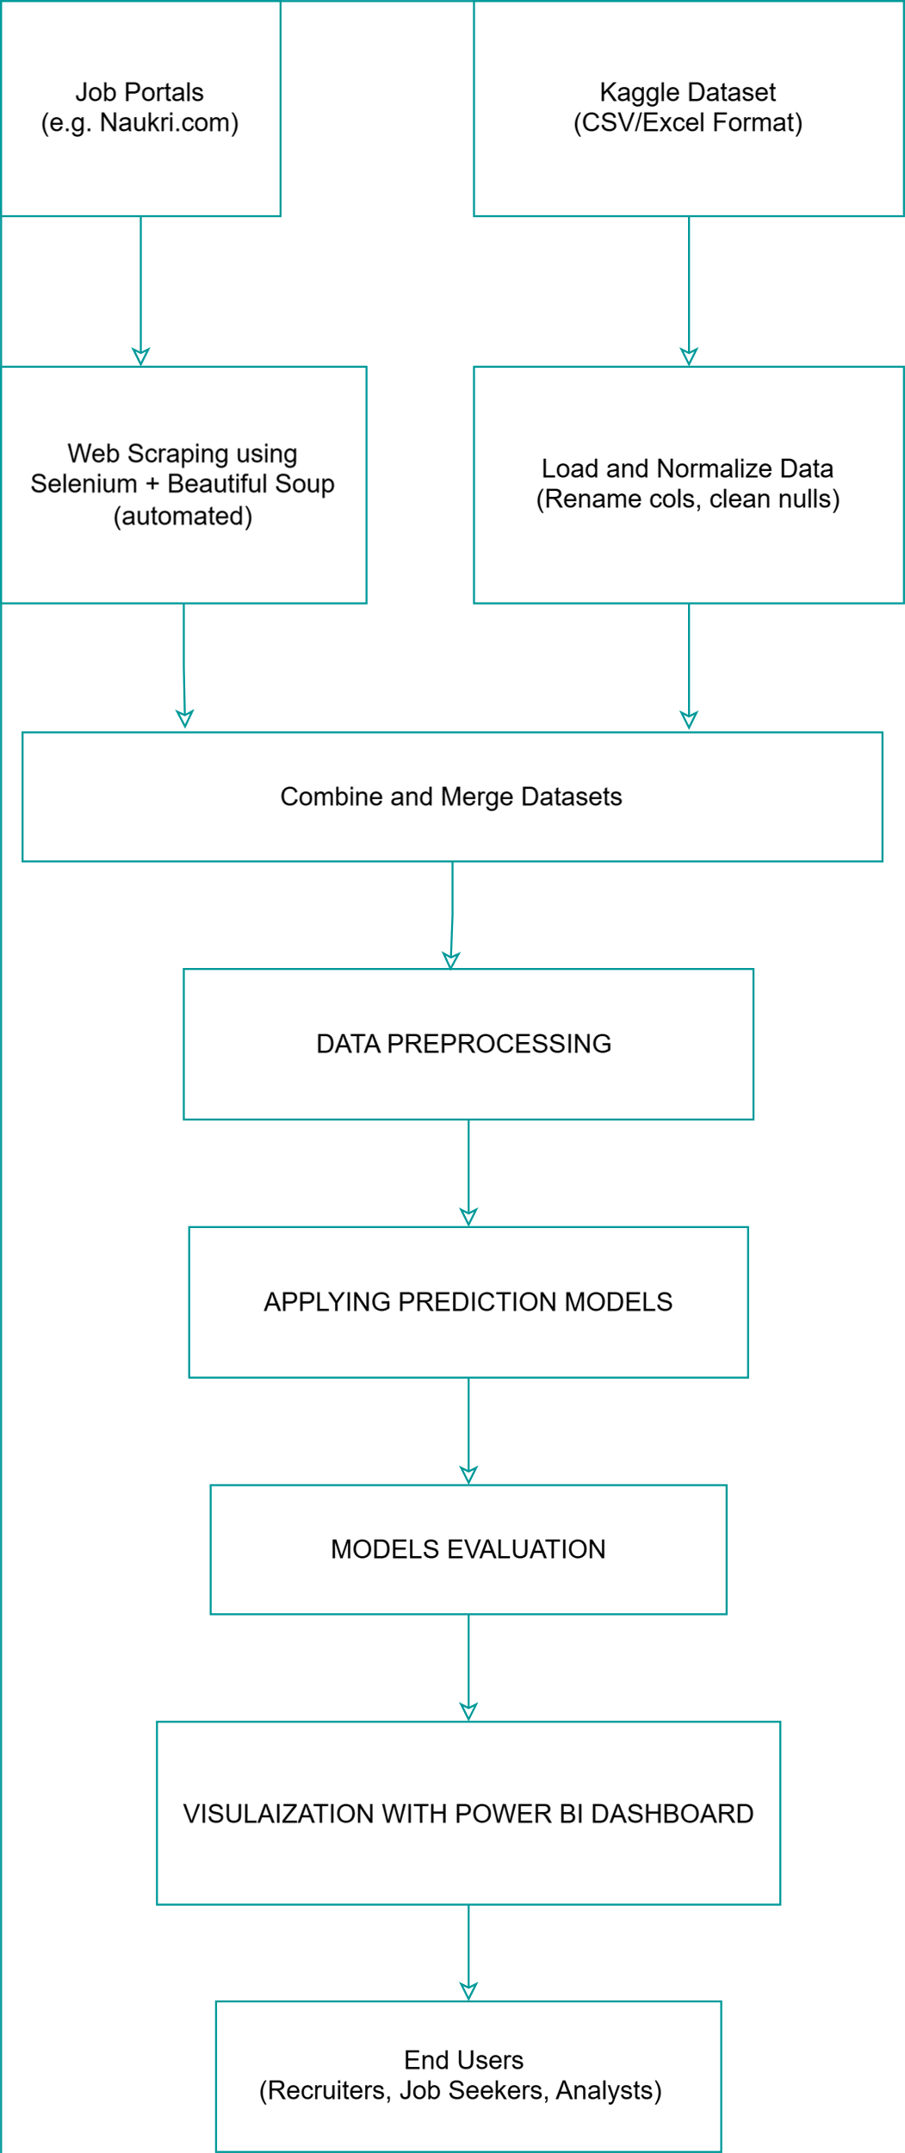
Step-by-Step Flow of Project Methodology

Slide 7

TOOLS & TECHNOLOGIES USED
Languages & Libraries
Python: Core language for scraping, processing, modeling
Pandas, NumPy: Data manipulation and analysis
Matplotlib, Seaborn: Visualization for EDA
Web Scraping Tools
Selenium: Dynamic content scraping (scrolling, clicking)
BeautifulSoup: Parsing and extracting HTML elements
Forecasting Models
ARIMA: Linear time series forecasting
Prophet: Trend, seasonality, changepoint detection
LSTM (Keras/TensorFlow): Deep learning for sequence modeling
Visualization Tool
Power BI: Interactive dashboards for job & salary insights

Slide 8



DATA COLLECTION AND PREPROCESSING
Sources
Primary: Naukri.com
Additional : Kaggle
Tools & Techniques
Selenium: Automated job search, dynamic content scraping
BeautifulSoup: Parsed HTML to extract job details
Pandas & NumPy: Cleaned and transformed data
Collected Fields
Job Title, Company, Location , Salary, Experience, Skills, Date Posted
Preprocessing Steps
Filled or dropped missing values
Standardized salaries, locations, and formats
Extracted features: skills, job roles, and city names

Slide 9
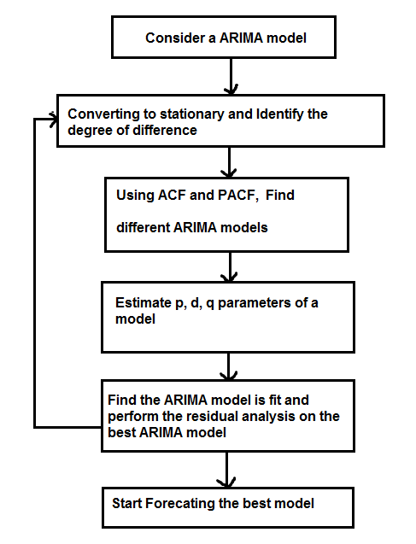
ARIMA Model – Code Implementation
ARIMA Model Implementation
Data Grouping
Group data by Field and Location
Aggregate Jobs Posted and Average Salary per Date
Preprocessing
Split data into Training set (70%) and Testing set (30%)
Model Building
Fit ARIMA (5,1,0) model separately on:
-Jobs Posted
-Average Salary
Forecasting
Forecast next 30 days for Jobs and Salary
Generate trend plots comparing train, actual, and forecasted data
Evaluation
Calculate error metrics for test data:
MAPE (Mean Absolute Percentage Error)
SMAPE (Symmetric Mean Absolute Percentage Error)
MASE (Mean Absolute Scaled Error)
Output
Save 30-day forecast results to CSV file
Display summary of metrics and plots for analysis

Slide 10
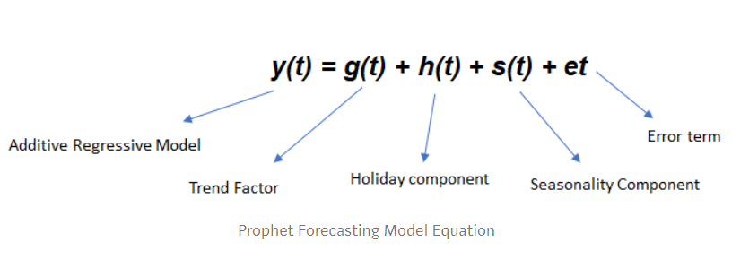
PROPHET Model – Code Implementation
PROPHET Model Implementation
Data Preparation
Convert dataset to prophet format
Train-Test Split
Split data into Training set (70%) and Testing set (30%)
Model Training
Initialize and fit Prophet model separately for Jobs and Salary data.
Forecasting
Predict on test set dates.
Forecast for next 30 days beyond dataset.
Evaluation
Calculate error metrics for test data:
MAPE (Mean Absolute Percentage Error)
SMAPE (Symmetric Mean Absolute Percentage Error)
MASE (Mean Absolute Scaled Error)
Output
Save 30-day forecast results to CSV file
Display summary of metrics and plots for analysis

Slide 11
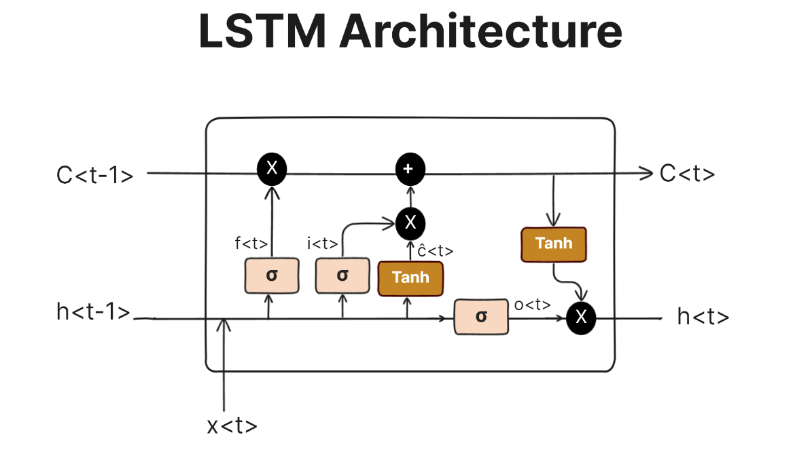
LSTM Model – Code Implementation
LSTM Model Implementation
Data Preparation
Convert time series data into supervised learning format (sliding window sequences)
Normalize features for better training stability
Train-Test Split
Split data into Training set (70%) and Testing set (30%)
Model Architecture
Built LSTM network with input, hidden, and output layers
Used activation functions and dropout for
Model Training
Train model on training sequences with multiple epochs.
Use Mean Squared Error (MSE) as loss function.
Evaluation
Calculate error metrics for test data:
MAPE (Mean Absolute Percentage Error)
SMAPE (Symmetric Mean Absolute Percentage Error)
MASE (Mean Absolute Scaled Error)
Output
Save 30-day forecast results to CSV file
Display summary of metrics and plots for analysis

Slide 12

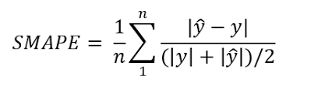
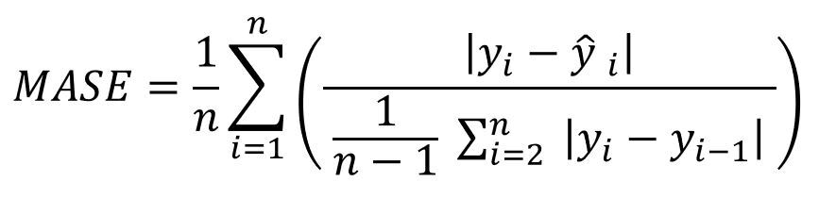
MODEL EVALUATION METRICS
Metrics Used for All Forecast Models:
MAPE (Mean Absolute Percentage Error) • Shows average prediction error in percentage terms • Easy to interpret – lower is better
SMAPE (Symmetric MAPE) • Considers both overestimation & underestimation • Balanced and scale-independent
MASE (Mean Absolute Scaled Error) • Compares forecast error with a naive baseline model • Helpful when datasets vary in scale

Slide 13
COMPARATIVE RESULTS AND VISUALIZATION
Model Comparison for Job Posting Prediction
Model Comparison for Salary Prediction
Model | Avg. MAPE (%) | Avg. SMAPE (%) | Avg. MASE
ARIMA | 36.82% | 30.81% | 0.793
Prophet | 35.25% | 29.00% | 0.745
LSTM | 64.64% | 33.6% | 0.75
Model | Avg. MAPE (%) | Avg. SMAPE (%) | Avg. MASE
ARIMA | 9.96%% | 9.54%% | 0.784
Prophet | 9.31% | 8.86% | 0.725
LSTM | 17.83% | 12.24% | 0.72
After observing the above tables;
Prophet emerges as the best model with least error.

Slide 14

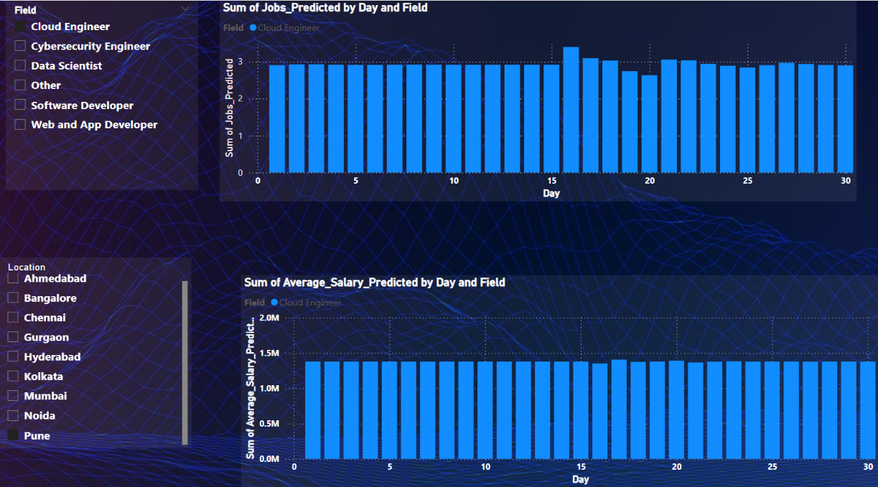
POWER-BI VISUALIZATION
Key Visualizations Created in Power BI
📌 Job Postings Overview
Total jobs by Field and Location shown in bar graphs
📈 Salary Analysis Dashboard
Bar graphs for showing average salary of different fields and locations.
🔮 Forecast Comparison Panel
30-day salary & job predictions visualized from Prophet model.
🌍 Using Slicer
Using slicer for selection of different fields and locations.

Slide 15

FUTURE SCOPE
Expand Data Sources: Scrape additional platforms like LinkedIn, Indeed, and Glassdoor for broader job market insights.
Enhance Models: Implement hybrid models (e.g., ARIMA-LSTM) or AutoML for improved prediction accuracy.
Real-Time Predictions: Develop a web/mobile app for live job and salary forecasts.
Advanced Visualizations: Integrate interactive dashboards with geospatial analysis for regional trends.

